Slide 1


Slide 2
UNDERGROUND MINING METHODS

Slide 3
Underground Mining Methods
Coal Mining
Bord and Pillar
Longwall
Blasting galllery
Metal Mining
Unsupported Mining
Supported Mining
Caving mining
Cut and fill
Stull
Square set
Room and Pillar
Stope and Pillar
Shrinkage
Longwall
Sublevel caving
Block caving
Sublevel

Slide 4
Longwall mining method:
Complete removal of the entire seam in one operation .
Leaving no pillars and allowing the roof to cave behind the face.
Provides continuous production and full potential for automation.

Slide 5
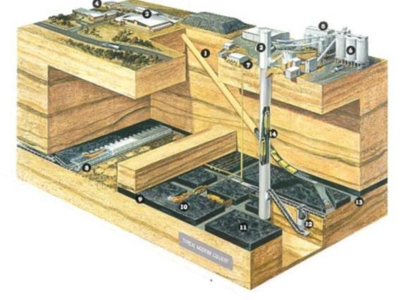
1. Drift for men and materials access
2. Shaft winder house
3. Bathhouse and administration building
4. Workshops
5. Coal preparation plant
6. Coal storage bins
7. Gas drainage system
8. Longwall face equipment
9. Coal seam
10. Continuous miner unit
11. Coal pillar
12. Underground coal bin
13. Main roadway or heading
14. Coal skips to carry coal to the surface

Slide 6
Types of longwall mining methods:
Retreat longwall mining method
Advance longwall mining method
Advance longwall mining method | Retreat longwall mining method
Requires small outlay for development return | Larger initial outlay with no intermediate
Mine produces coal in a relatively short time | Extensive development opening must be maintained during the life of the mine
Ventilation is less effective | Ventilation is more effective
Maintenance of haulage and airways is difficult, these opening pass through caved ground and the packwalls supporting them often give trouble from settlement. | Avoids cost of building and maintaining packwalls .

Slide 7
Blasting gallery method:
Induced caving by blasting during depillaring of panels in underground mines
BG method is a semi mechanized caving method, which involves retreating along level galleries, while extracting the maximum possible thickness of the seam
BG method involves splitting along the level of developed pillars in the bottom section into two rectangular stooks and adequately supporting the widened galleries by hydraulic props and roof bars at least two pillars ahead of the pillar under extraction.

Slide 8
Advantages of blasting gallery method:
Less capital intensive as compared to longwall
Less skilled manpower needed compare to longwall
Higher production (400-500 t/day/panel) and productivity
Extraction of hard coal not suitable for ploughs and shearer
Extraction of small size panels not suitable for longwall method
In case of BG failure, equipments can be used for heading drivages
The workers/operators are always under the supported roof

Slide 9
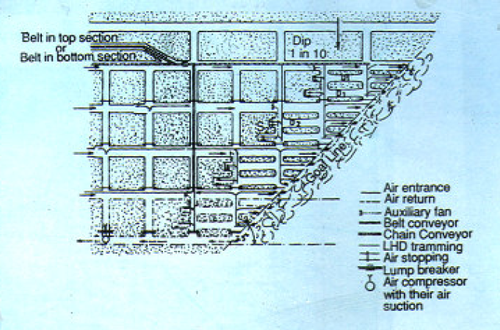
Depillaring layout and LHD tramming in blasting gallery method

Slide 10
Room-and-pillar/ Stope-and-pillar mining
Maximum part of ore body is excavated.
Sections of ore is left as pillars to support the hanging wall.
They can be circular, square or shaped as elongated walls, separating the stopes.
The ore remaining in the pillars can be extracted by robbing.

Slide 11
Applications:
Ore bodies with horizontal or flat dip, inclination not exceeding 30⁰.
Competent rock in the hanging wall and ore.
Types:
Flat room-and-pillar mining
Inclined room-and-pillar mining
Step room-and-pillar mining

Slide 12
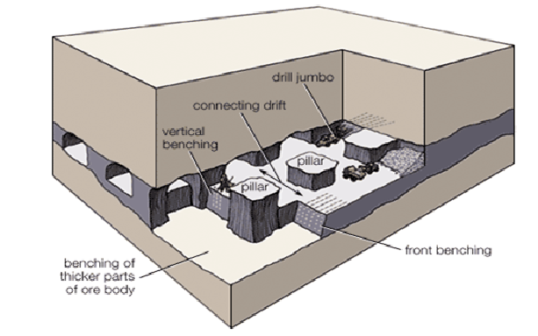
Flat room-and-pillar mining:

Slide 13
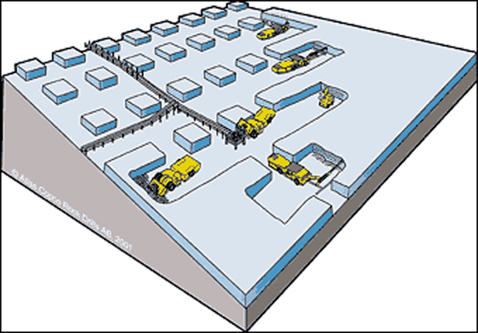
Inclined room-and-pillar mining:

Slide 14
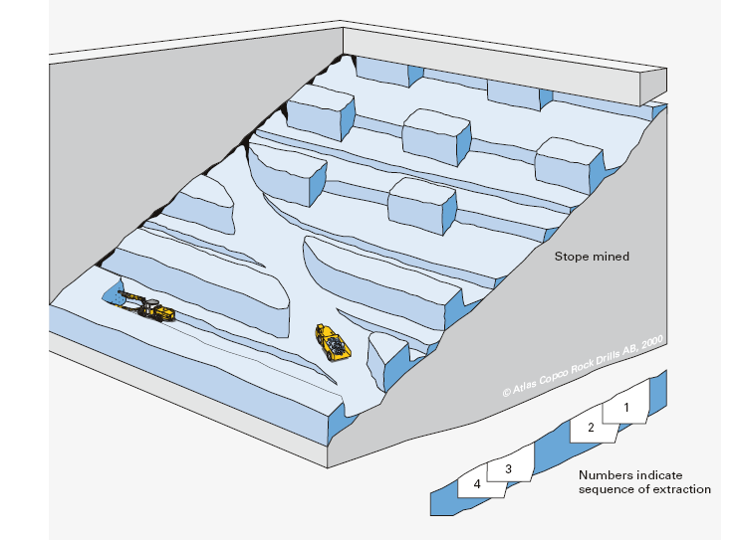
Step room-and-pillar mining:

Slide 15
Shrinkage stoping mining method:
The ore is excavated in horizontal slices, starting from the bottom of the stope and advancing upwards.
Part of the broken ore is left to support the stope walls.
Smaller ore bodies can be mined with a single stope.
Larger ore bodies are divided into separate stopes.
Pillars can be recovered upon completion of the regular mining.

Slide 16
Applications:
Shrinkage stoping can be used in ore bodies with:-
Steep dip; dip mist exceed the angle of repose
Firm ore
Comparatively stable hanging wall and footwall
Regular ore boundaries
Ore that is not affected by storage in the stope (certain sulphide ores tend to oxidize and decompose when exposed to the atmosphere).

Slide 17
Development:
The development for shrinkage stoping consists of:-
Haulage drift along the bottom of the stope
Crosscuts into the ore underneath the stope
Finger raises and cones from the crosscuts to the undercuts
An undercut or complete bottom slice of the stope at a level of 5-10m above the haulage drift
Raise from haulage level passing through the undercut up to the main level above, to provide access and ventilation to the stope.

Slide 18
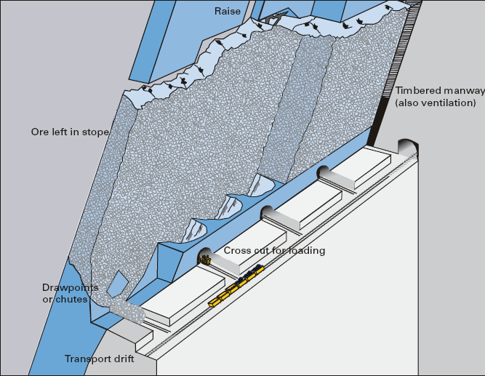
Shrinkage stoping with cross-cut loading

Slide 19
Sublevel stoping mining method:
The ore body is divided vertically by driving crosscuts and haulage levels every 150 to 400ft (45 to 120m).
A collection system is constructed, during which time the stope block is all or partially undercut.
Sublevels are driven through the proposed stope block every 30 to 180ft (10 to 55m).
Shrinkage stoping has also been used to form the starting slot that may be developed at the end or middle of the stope.

Slide 20
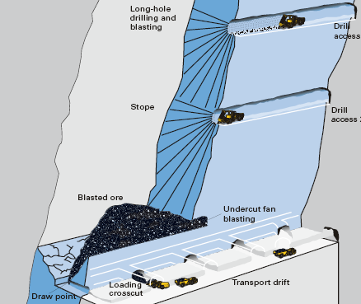
Sublevel stoping layout

Slide 21
Cut and fill method:
Ore is extracted in horizontal slices starting from the bottom of a stope and advancing upwards.
After excavating the ore the corresponding volume is filled with waste material like waste rock etc.
The filling material can be mixed with cement to produce a harder surface.
Cut and fill mining can be applied in steeply dipping ore bodies with reasonably firm ore.

Slide 22
Development:
It consists of:
Haulage drifts along the ore body at the main level.
Short raises and manways to an undercut, 5-10m above the haulage drift level.
Undercut of the complete stope area.

Slide 23
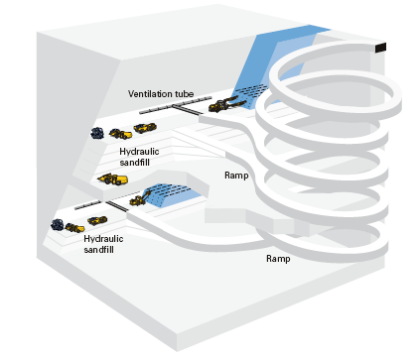
Layout of cut and fill mining

Slide 24
Stull supporting system:
Stull sets are applicable to Ore bodies that dip 70 degree Or more, have very weak walls, and are not more than 20 ft in width.
The stull sets prevent movement of the walls on the mining floor until sand fill can be poured.
The stull consists of two posts, a cap and two squeeze headings.
The caps are round timber, 12 to 24 inches in Diameter, depending upon the span.

Slide 25
Square sets:
This method is primarily used where the walls of the stope are weak, or if the ore body is too wide for stull timbering.
The ore is excavated in blocks of approximately the same size, ranging from 5 to5 by7 ft to 6 to6 by 8 ft.
A square set is composed of a vertical post and the horizontal members, cap and girt.
The cap is laid in the direction of maximum lateral pressure and is the main load bearing member.

Slide 26
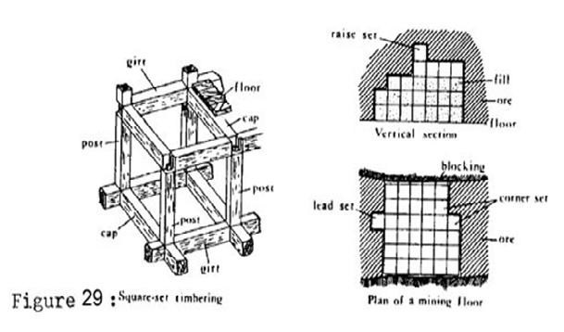
Square set stoping

Slide 27
Caving methods:
Caving mining methods that are based on a planned caving of rocks above and/or at times surrounding the material being mined can be classified in three broad categories:
Sublevel Caving
Block Caving
Longwall mining method

Slide 28
Sublevel caving method:
Sublevel caving is a mass mining method based upon gravity flow of blasted ore and caved waste rock.
Its major advantage is safety.
There is relatively high dilution of ore by caved waste.
Some ore is lost in passive zones between those of active flow.

Slide 29
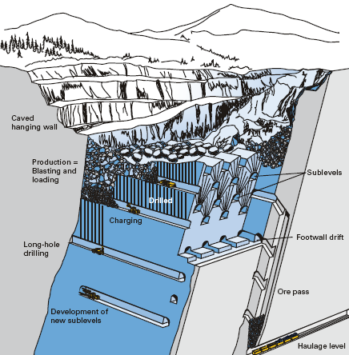
Typical sublevel caving layout

Slide 30
Block caving method:
Block caving is usually used to mine large ore bodies that have consistent grade throughout.
BLOCK CAVING is the lowest cost of all mining methods.
It is a mass mining method where the extraction and breaking of ore depends largely on gravity.

Slide 31
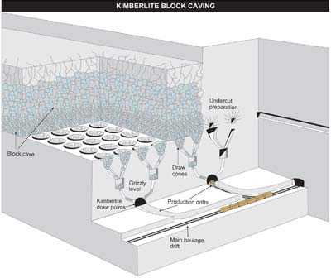
Block caving mining method

Slide 32
There are three major systems of recovering the broken ore from the block cave:-
THE GRIZZLY SYSTEM- it is a full gravity system wherein ore from the draw points flows directly to transfer raises after sizing at the grizzly.
THE SLUSHER SYSTEM- it uses a slusher scraper for the main production unit. It is used where rock breaks into moderate-sized fragments.
LHD SYSTEM –it is used where rock breaks into relatively large fragments..

Slide 33
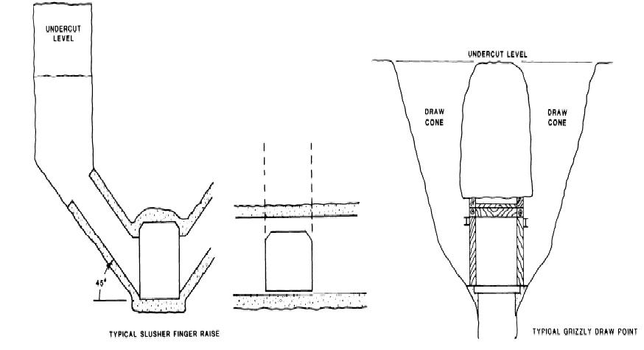

Slide 34
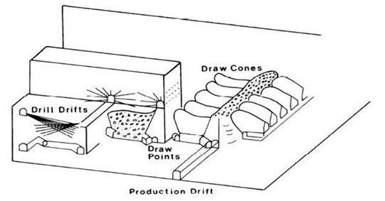
LHD system-typical layout

Slide 35
Factors which affects the selection of mining method
Spatial characteristics of the deposit:-
a. Size (especially height, thickness, and overall dimensions)
b. Shape (tabular, lenticular, massive, or irregular)
c. Attitude (inclination or dip)
d. Depth (mean and extreme values, strpping ratio)
e. Regularities of the ore boundaries
f. Existence of previous mining

Slide 36
Geological and hydrologic conditions:-
a. Mineralogy and petrography (e.g., sulphides vs. oxides in copper)
b. Chemical composition (primary and secondary minerals)
c. Deposit structure (folds, faults, discontinuities, intrusions)
d. Planes of weakness (joints, fractures, shear zones, cleavage in minerals, cleat in coal)
e. Uniformity of grade
f. Alteration and weathered zones
g. Existence of strata gases

Slide 37
Geotechnical (soil and rock mechanics) properties:-
a. Elastic properties (strength, modulus of elasticity, poisson’s ratio etc.)
b. Plastic or viscoelastic behavior (flow, creep)
c. State of stress (premining, postmining)
d. Rock mass rating (overall ability of openings to stand unsupported or with support)
e. Other physical properties affecting competence (specific gravity, voids, porosity, permeability, moisture content, etc.)

Slide 38
Economic considerations:-
a. Reserves (tonnage and grade)
b. Production rate (output per unit time)
c. Mine life (total operating period for development and exploitation)
d. Productivity (tons or tonnes/employee hour)
e. Comparative mining costs of suitable methods
f. Comparative capital costs of suitable methods

Slide 39
Technological factors:-
a. Recovery (proportion of the ore that is extracted)
b. Dilution (amount of waste that must be produced with the ore)
c. Flexibility of the method to changing conditions
d. Selectivity of the method (ability to extract ore and leave waste)
e. Concentration or dispersion of workings
f. Ability to mechanize and automate
g. Capital and labor intensities

Slide 40
Environmental concerns:-
a. Ground control to maintain integrity of openings
b. Subsidence, or caving effects at the surface
c. Atmospheric control (ventilation, air quality control, heat and humidity control)
d. Availability of suitable waste disposal areas
e. Workforce (availability, training, living, community conditions)
f. Comparative safety conditions of the suitable mining methods

